Slide 1

STUDENT PERFORMANCE PREDICTION

Slide 2



PROBLEM sTATEMENT
Students often struggle academically due to multiple factors such as study habits, test preparation, parental education, and socio-economic background. Teachers and institutions lack a data-driven method to identify at-risk students early. The problem is to build a machine learning model that predicts a student's performance (final grade) based on various academic and demographic features, so that timely interventions can be provided.

Slide 3
Aim of the project
The aim of this project is to analyze student-related factors such as study hours, attendance, parental background, test scores, and socio-economic indicators, and to build an optimized machine learning classification model that accurately predicts their final grade or performance level. The system aims to support early intervention and improve academic decision-making.

Slide 4
WORKFLOW
DATA
LOADING
Import
libraries
EDA
DATA CLEANING AND
PREPROCESSING
Numpy
Null
Hanadling
Standard
Scalar
Pandas
Matplotlib
Splitting
Data
Encoding
Dropping
Sklearn
Random
Forest
SVM
(RBF Kernel)
Logistic
Regression
Model Training And
Comparison
XGBoost
k-NN
Final
Evaluation

Slide 5
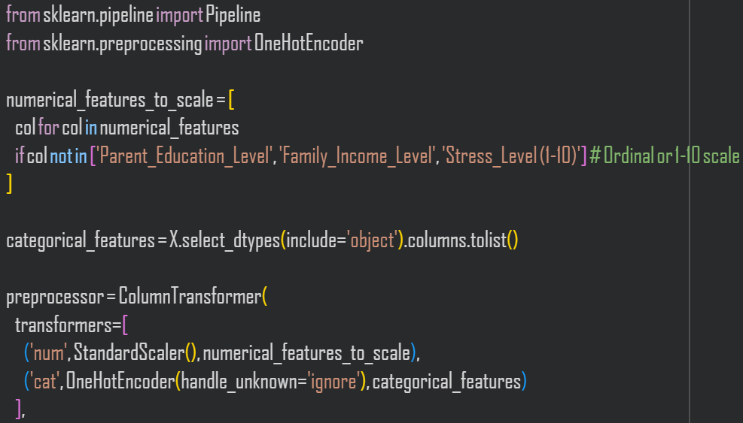
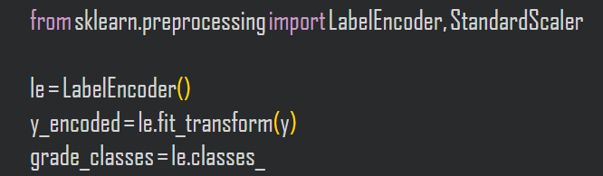
PREPROCESSING
Data preprocessing is the process of cleaning, transforming, and organizing raw data into a structured and usable format so that machine learning models can understand it and learn effectively.
Removal of Irrelevant Columns
  Certain columns do not contribute to prediction and only add noise.
  So we dropped Student_ID, First_Name, Last_Name, Email, Total_Score.
Handling Missing Values
  After transformation:
  Dataset was checked for NaN values
  Any missing values were replaced with 0
ORDINAL ENCODING
High School | 0
Bachelor’s | 1
Master’s | 2
PhD | 3
LOW | 0
MEDIUM | 1
HIGH | 2

Slide 6
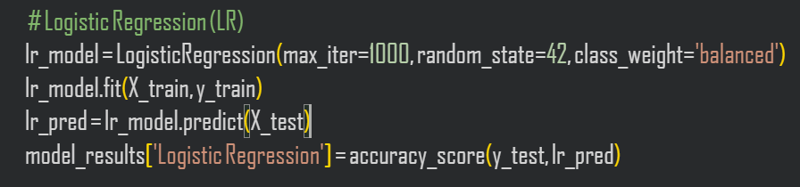
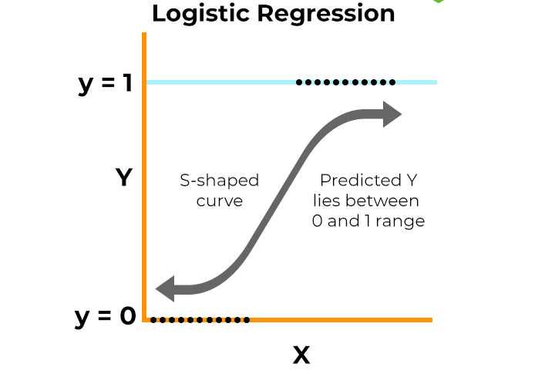
CLASSIFICATION MODELS
1. LOGISTIC REGRESSION
Logistic regression is used for binary classification where Sigmoid function is used , that takes input as independent variables and produces a probability value between 0 and 1.
https://www.geeksforgeeks.org/machine-learning/understanding-logistic-regression/

Slide 7
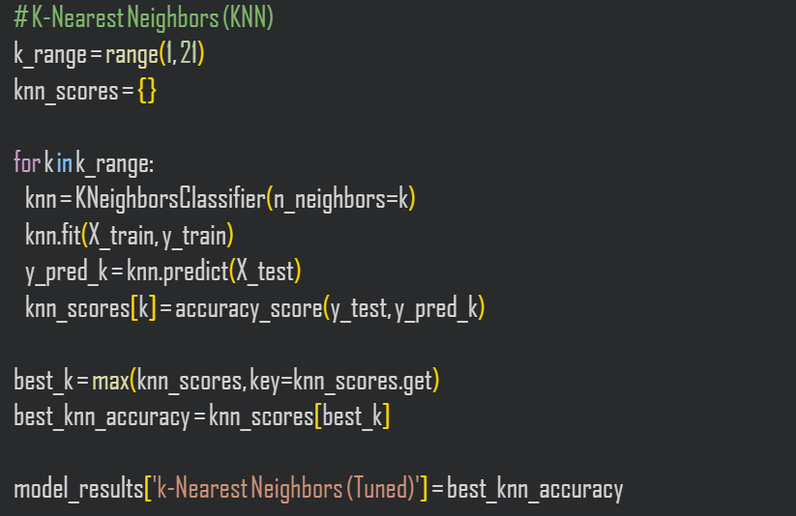
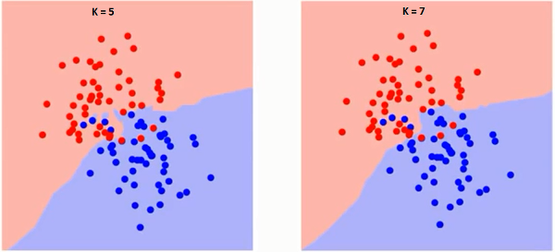
2. K-Nearest Neighbors (KNN)
A lazy learning algorithm that classifies a data point based on the majority class of its nearest neighbors.
How It Works:
Calculates distance (Euclidean) between students
Finds k nearest neighbors
Chooses the most common grade among them
https://www.geeksforgeeks.org/machine-learning/k-nearest-neighbours/

Slide 8
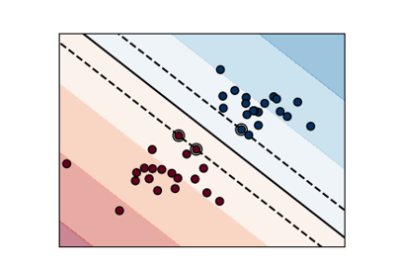
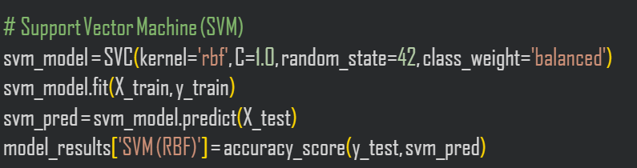
3. Support Vector Machine
A powerful classifier that finds the best boundary (hyperplane) that separates classes.
Maps data to a higher dimension using kernel
Finds boundary that maximizes margin between grade groups
https://www.geeksforgeeks.org/machine-learning/support-vector-machine-algorithm/

Slide 9
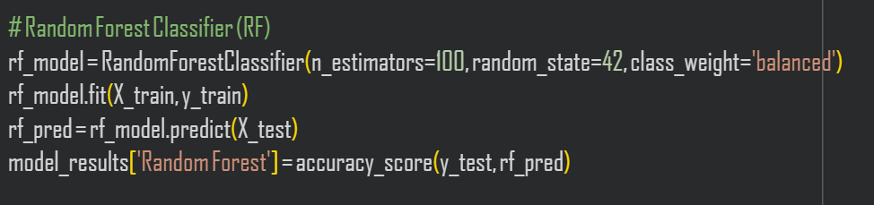
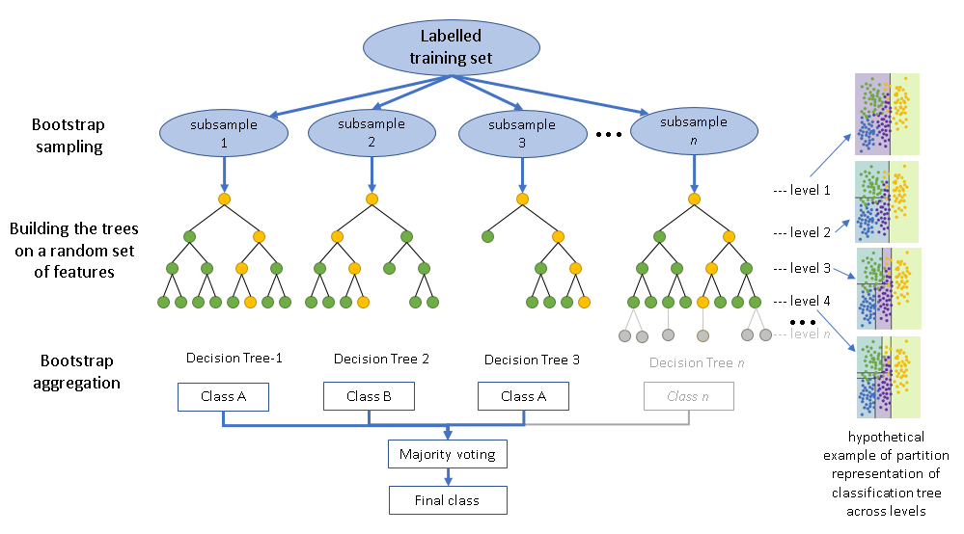
4. Random Forest Classifier
An ensemble model that builds multiple decision trees and combines their predictions.
Trains many decision trees
Each tree votes for a grade
Final grade decided by majority vote
https://www.geeksforgeeks.org/dsa/random-forest-classifier-using-scikit-learn/

Slide 10
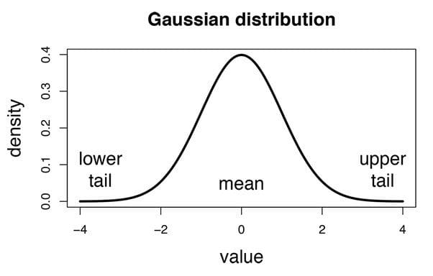
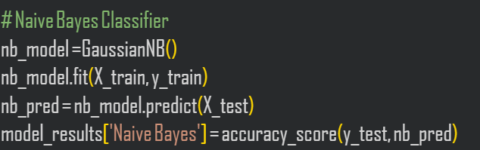
5. NAIVE BAYES CLASSIFIER
The “Naive” part of the name indicates the simplifying assumption made by the Naïve Bayes classifier. The classifier assumes that the features used to describe an observation are conditionally independent, given the class label. The “Bayes” part of the name refers to Reverend Thomas Bayes, an 18th-century statistician and theologian who formulated Bayes’ theorem.
Posterior
Priori
Likelihood
P(A∣B)=P(A)P(B∣A)
​ P(B)
Marginal
https://www.geeksforgeeks.org/machine-learning/naive-bayes-classifiers/

Slide 11
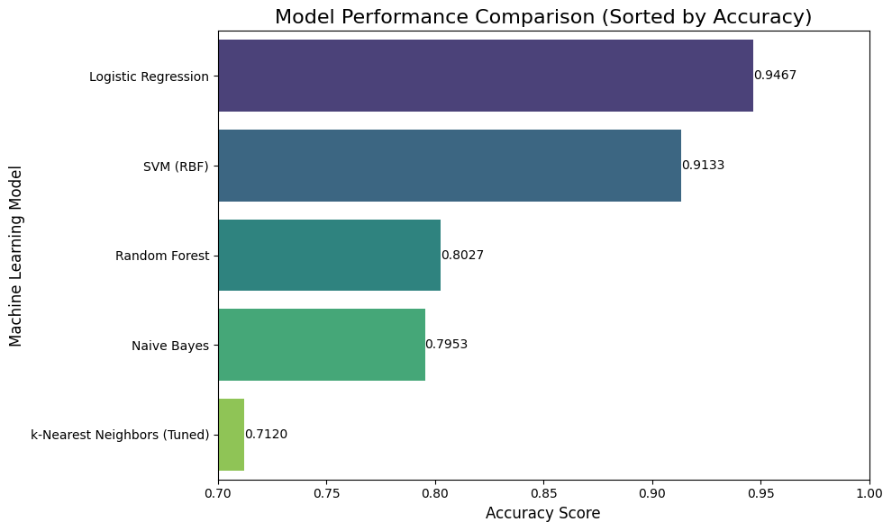
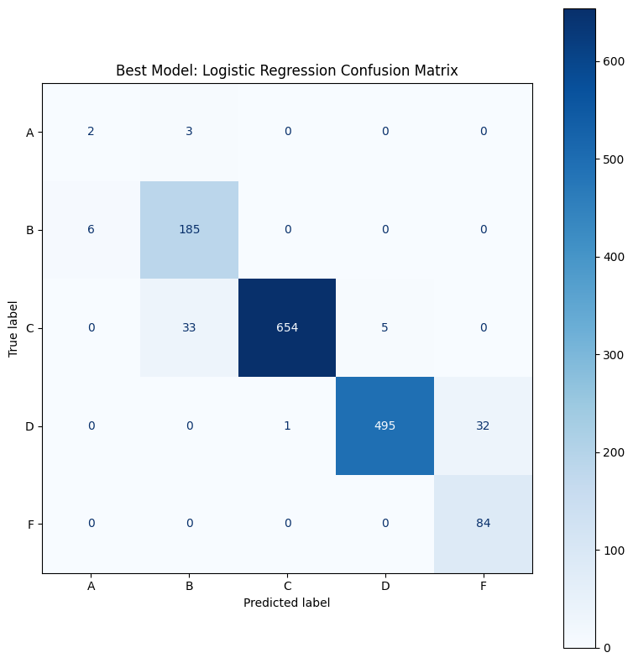
PREDICTION AND RESULT
BY ANALYSING THE COMPARISON BEST MODEL
FOR STUDENT PERFORMANCE IS LOGISTIC REGRESSION
MODEL PERFORMANCE(ACCURACY) COMPARISON:
LOGISTIC REGRESSION CONFUSION METRICS:

Slide 12
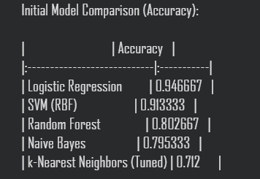
CONCLUSION
The comparison of five machine learning models clearly shows that Logistic Regression performs the best for predicting student performance in this dataset, achieving an accuracy of 94.66%, which is significantly higher than all other models.
SVM (RBF) also performed well (91.33%), indicating that nonlinear relationships exist in the data, but its performance was still slightly lower than Logistic Regression.
Random Forest (80.26%) and Naive Bayes (79.53%) showed moderate performance, suggesting they struggled with the high-dimensional encoded features or class distribution.
KNN, even after tuning, achieved the lowest accuracy (71.2%), showing that distance-based methods are not ideal when feature scaling, dimensionality, and class separation are complex.
MODEL WITH THEIR ACCURACY:

Slide 13

Thank You!

